Slide 1
Class Design
3.1-3.3

Slide 2

Instance Variables and Encapsulation
Figure 1 Tally counter
Each counter needs to store a variable that keeps track of the number of simulated button clicks.

Slide 3
Instance Variables
Instance variables store the data of an object.
Instance of a class: an object of the class.
An instance variable is a storage location present in each object of the class.
The class declaration specifies the instance variables:
public class Counter
{
private int value;
...
}
An object's instance variables store the data required for executing its methods and tracking its state

Slide 4
Instance Variables
An instance variable declaration consists of the following parts:
access specifier (private)
type of variable (such as int)
name of variable (such as value)
You should declare all instance variables as private.

Slide 5
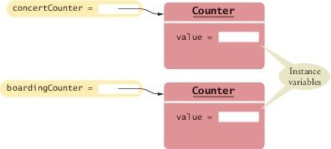
Instance Variables
Each object of a class has its own set of instance variables.

Slide 6
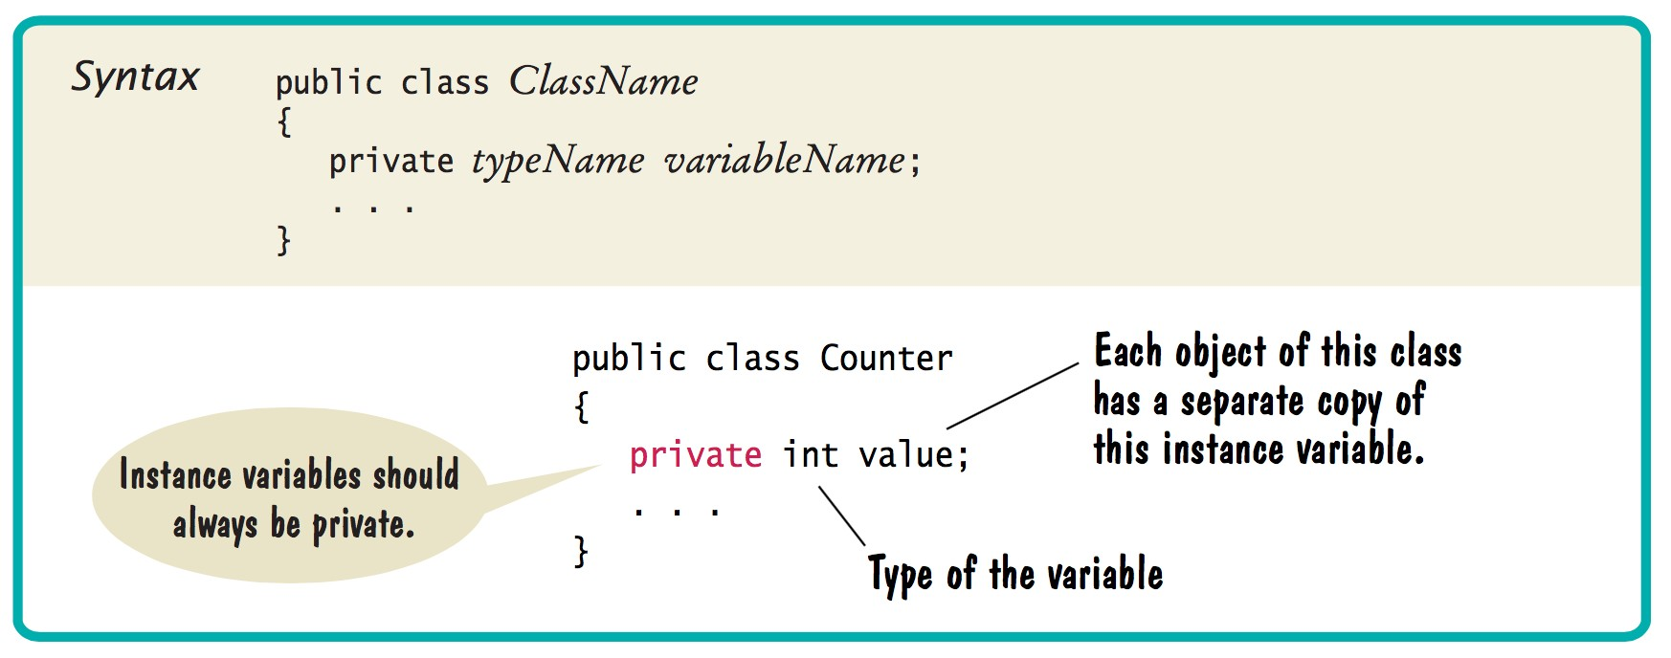
Syntax 3.1 Instance Variable Declaration

Slide 7

Instance Variables

Slide 8
Constructors
Creates and Initializes objects
Set the initial data for objects
Similar to a method with two differences:
The name of the constructor is always the same as the name of the class
Constructors have no return type

Slide 9
Class Design
Public Class ClassName
{
Instance Variables
Constructors
Methods
}

